Slide 1

Robots

Slide 2
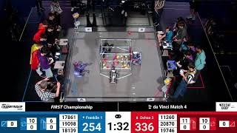

Slide 3
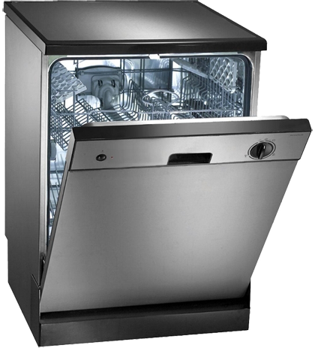
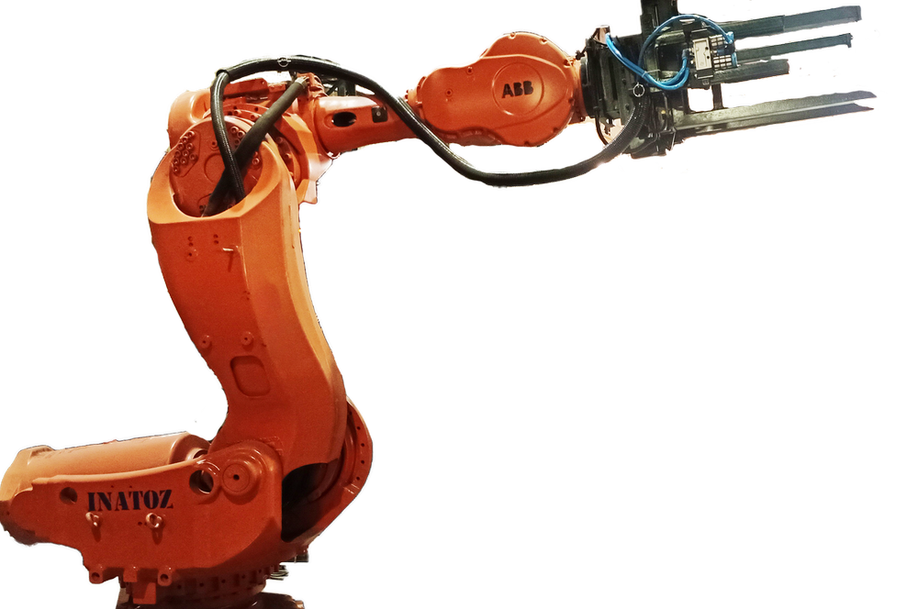
What is?
The definition of robot varies on who you ask; according to Britannica: a machine with a specific purpose, that replaces human effort
But from the programming perspective: it is a bunch of inputs and outputs.
https://www.britannica.com/technology/robot-technology

Slide 4
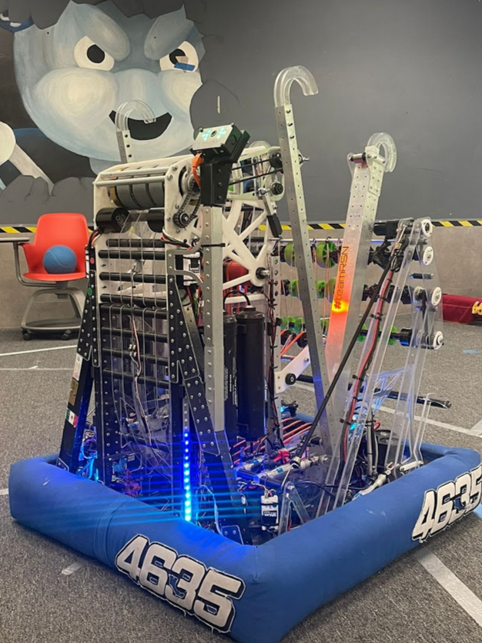
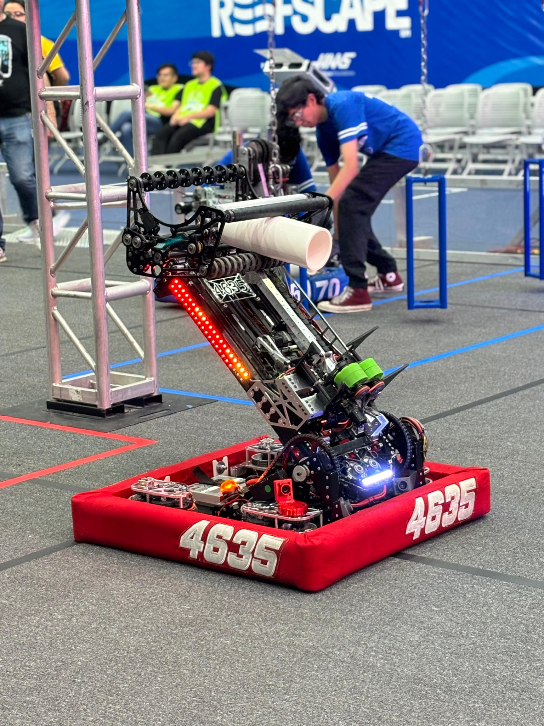
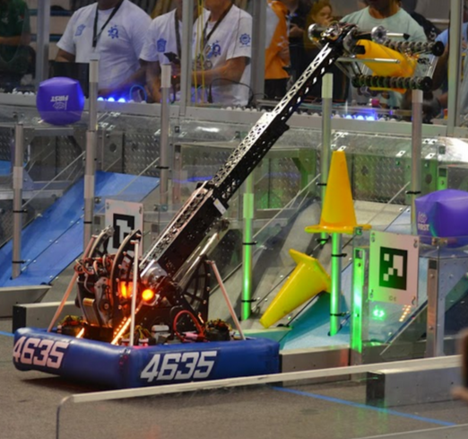
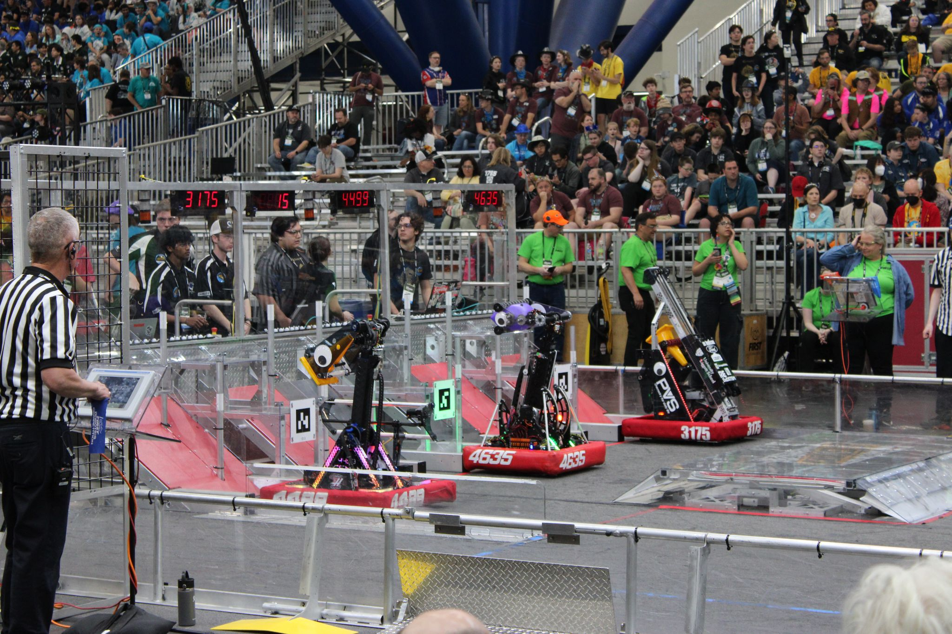
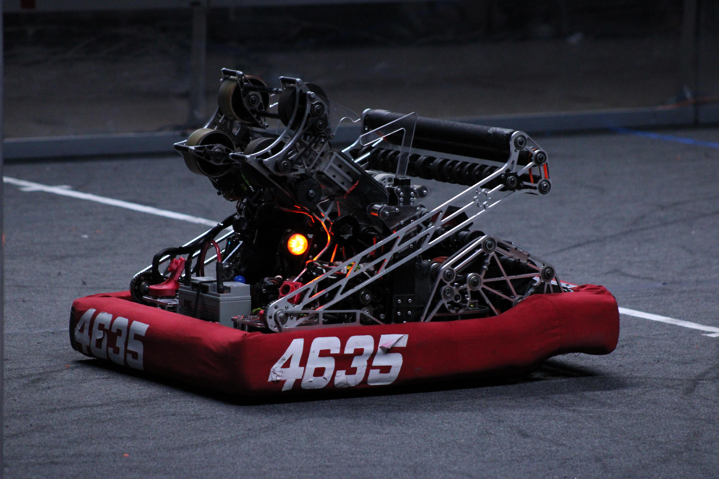
FRC Robots
They have a task to complete and that is what robots do.

Slide 5
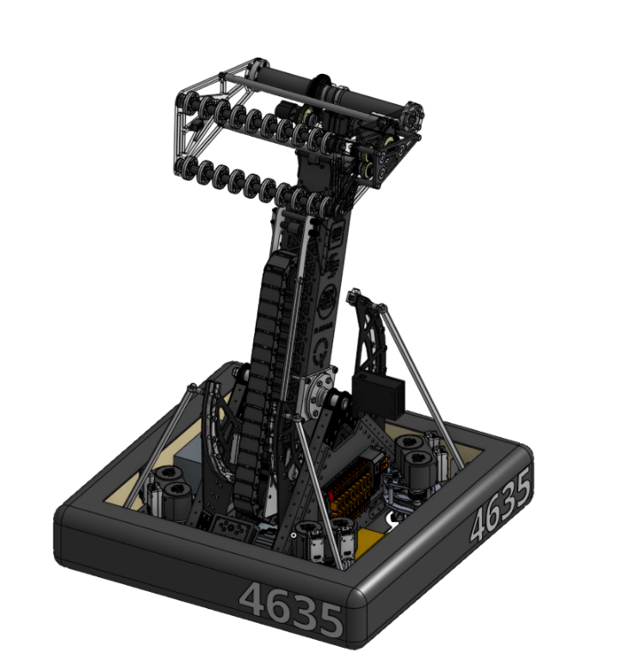
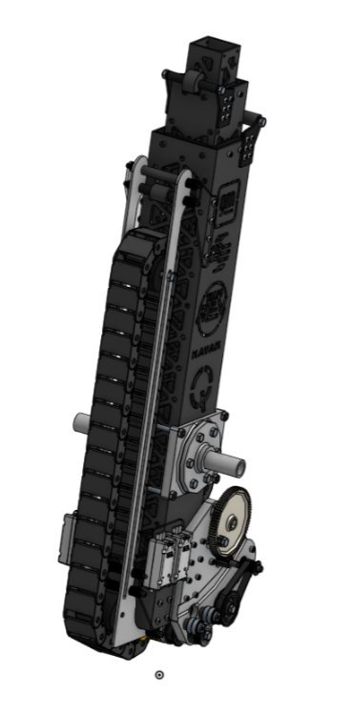
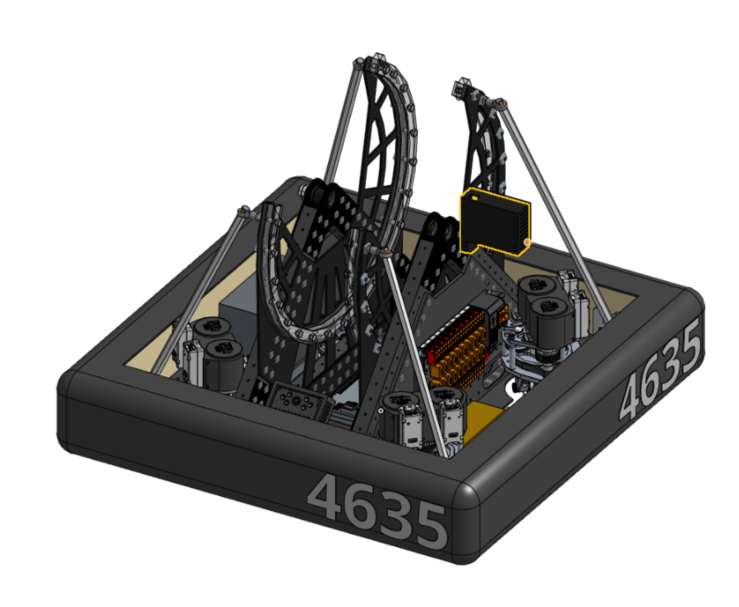
Mechanisms
Mechanisms are what make the robot up, each robot has one or more mechanisms, they act partially independently. A set of actuators that move a certain thing.
The chassis, the arc, the wrist, the telescopic arm, they are all the individual mechanisms of this year’s robot.

Slide 6
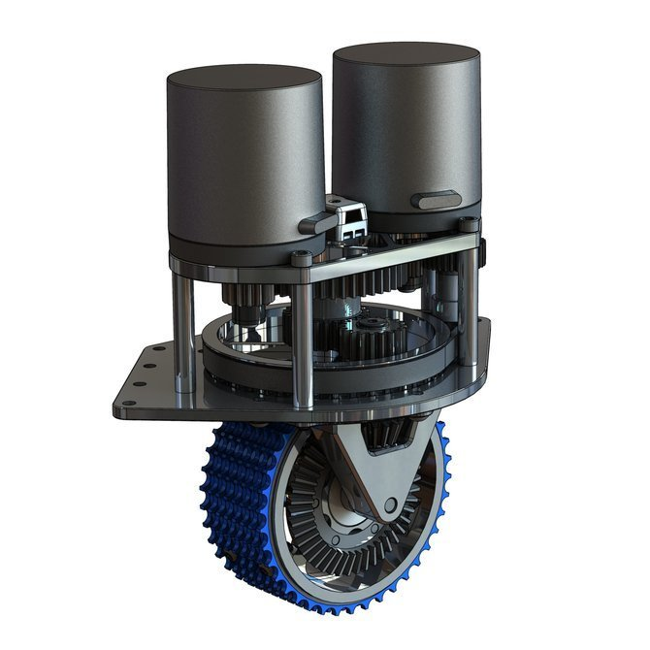
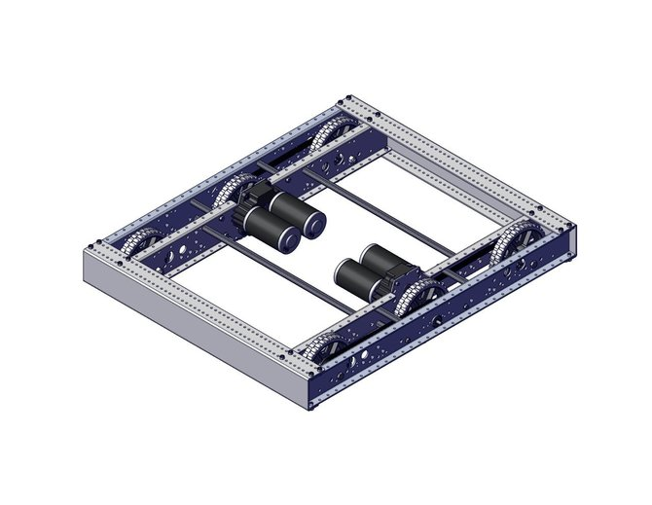
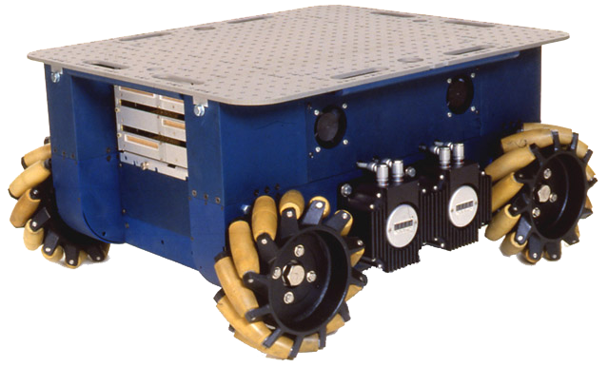

Drive Trains
This is the mechanism that is responsible for moving the robot on the field. It can be holonomic, which means that it can move in any direction plus turn at the same time.

Slide 7
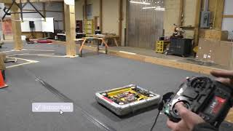
Drive Trains
Swerve Drive

Slide 8
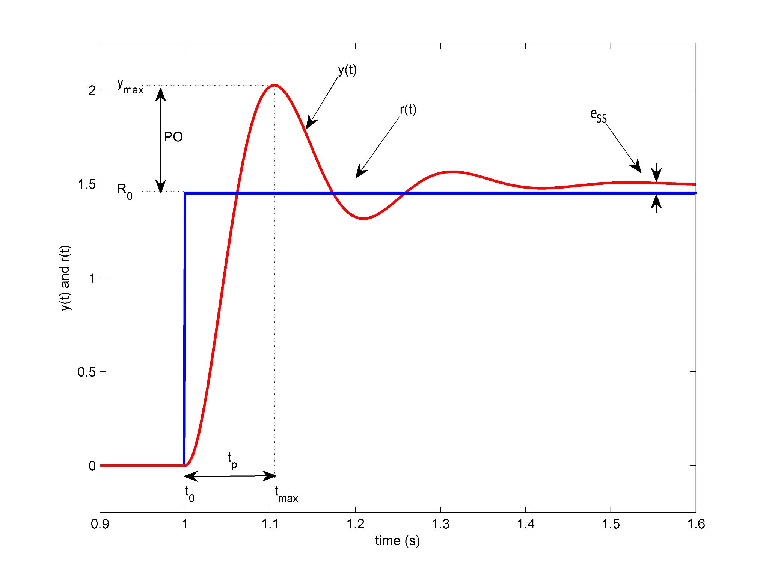
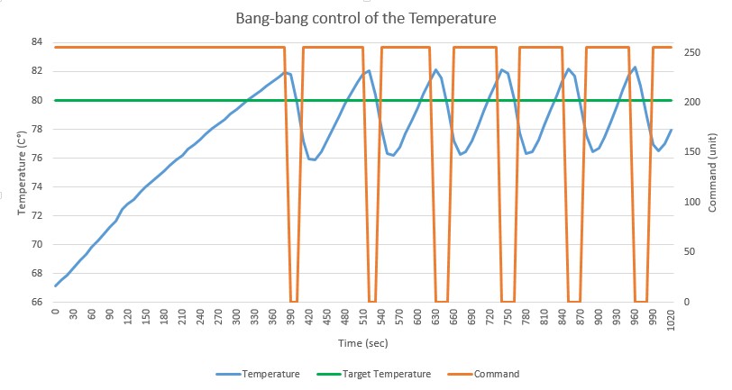
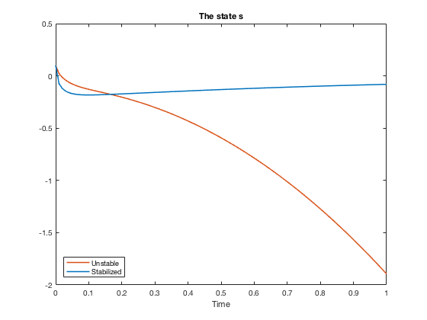
Control
The ability to move a mechanism in a desired manner is control, we can achieve that in different ways. PID, bang bang, State Space, Hysteresis, etc. It changes depending on the mechanism. The value to be reached is called the setpoint, where you are at is called the state and the difference between the two is called the error.

Slide 9
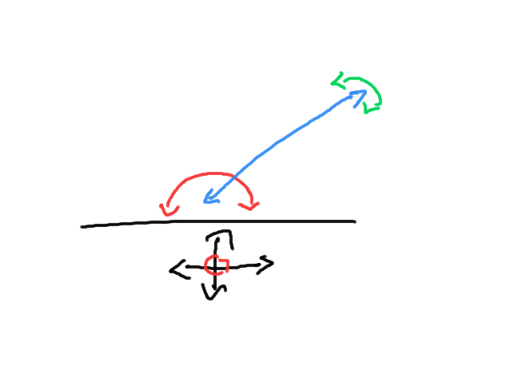
Abstraction in mechanism
What is the simplest way that you can image a robot to be, that is the way to go. All mechanism have a unit to represent them, that could be a position units a velocity units n acceleration unit a heat unit alight units, etc.
The chassis move at x or y m/s or rotate at x rads/s
The telescope can be at x meters.
And the arc can be at x radians.
They all have a number to represent them.

Slide 10
In code they are all just numbers
There is no other way to put it, in code they are represented by a bunch on numbers.

